Slide 1


Projet
robotique
Brique vision
FROUIN Tanguy 5IRC

Slide 2
Sommaire
1
4
2
5
3
6
7
Sujet
Difficultés
Technologies
Bilan personnel
Fonctionnalités
Sources
Démo
FROUIN Tanguy 5IRC

Slide 3
1
Sujet
FROUIN Tanguy 5IRC

Slide 4
Sujet
Caractériser à partir d’une caméra 3D :
Objets
Détection
Taxonomie (“Aliment” -> “fruit” -> “pomme”, …)
TF (x, y, z)
Personnes
Attributs (genre, âge, lunettes, …)
Position (assis, debout, couché, …)
TF (x, y, z)
FROUIN Tanguy 5IRC

Slide 5
2
Technologies
FROUIN Tanguy 5IRC

Slide 6





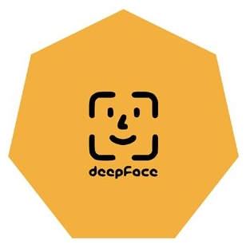
2) Technologies
FROUIN Tanguy 5IRC

Slide 7
3
Fonctionnalités
FROUIN Tanguy 5IRC

Slide 8
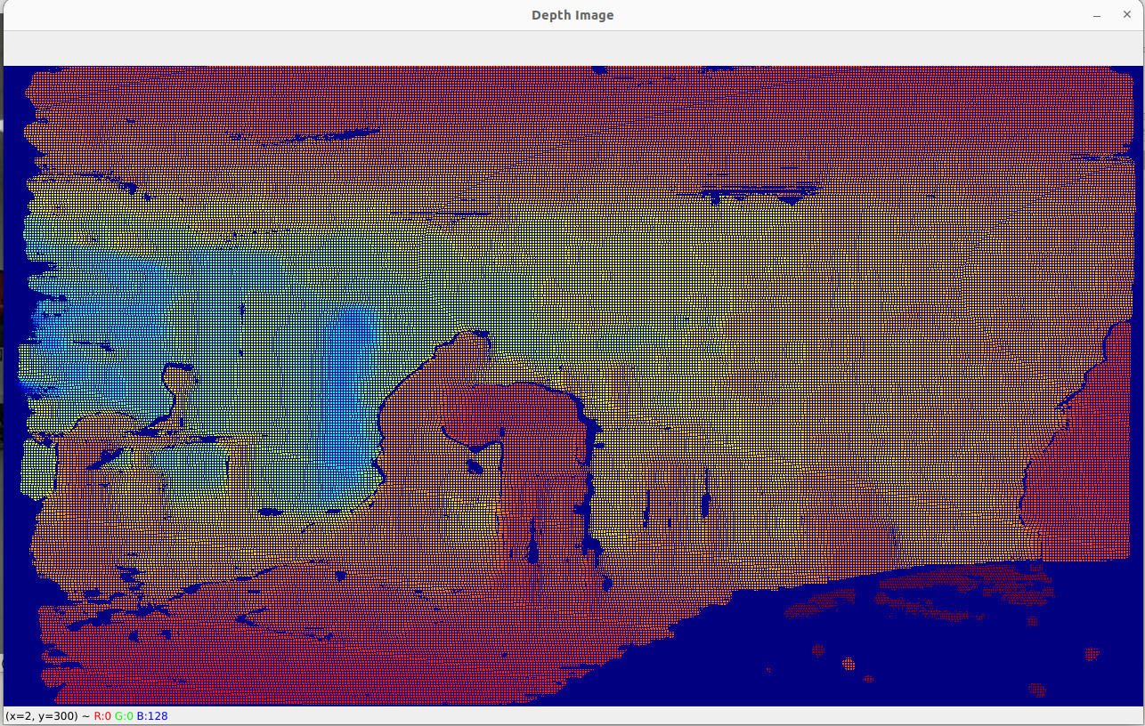
3) Fonctionnalités
FROUIN Tanguy 5IRC

Slide 9
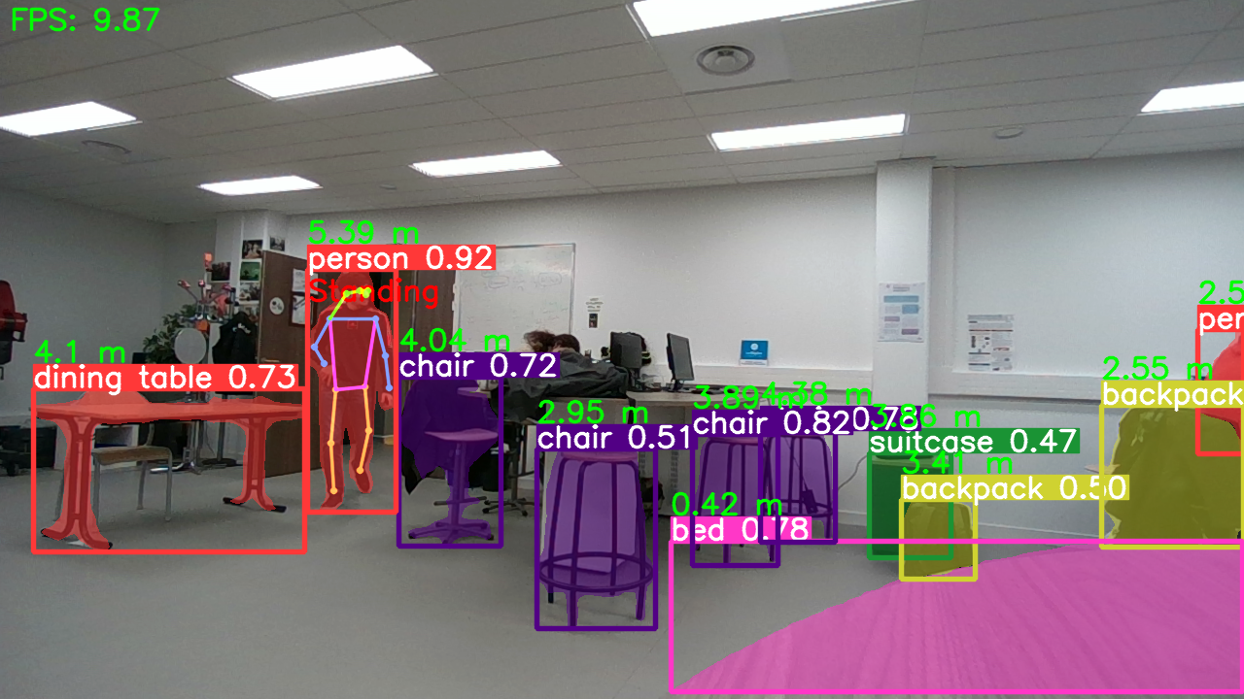
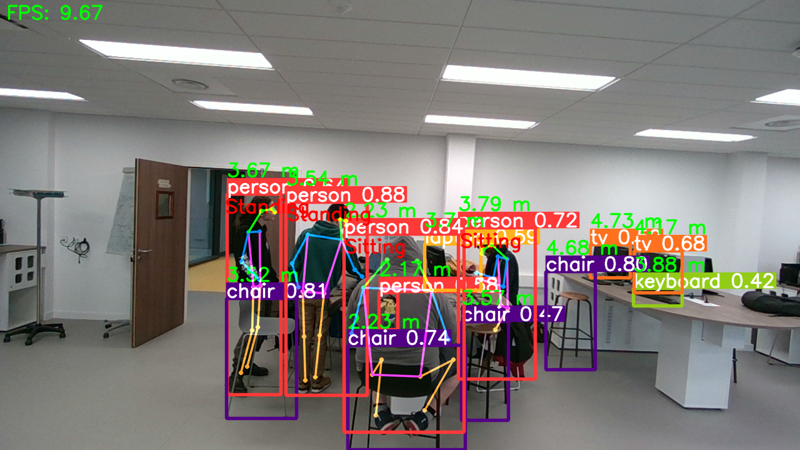
3) Fonctionnalités
FROUIN Tanguy 5IRC

Slide 10
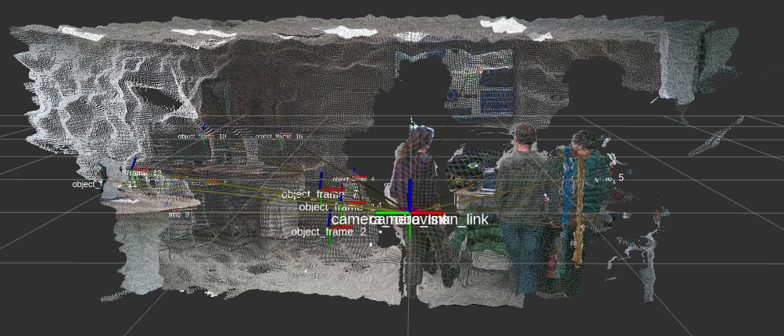
3) Fonctionnalités
FROUIN Tanguy 5IRC

Slide 11
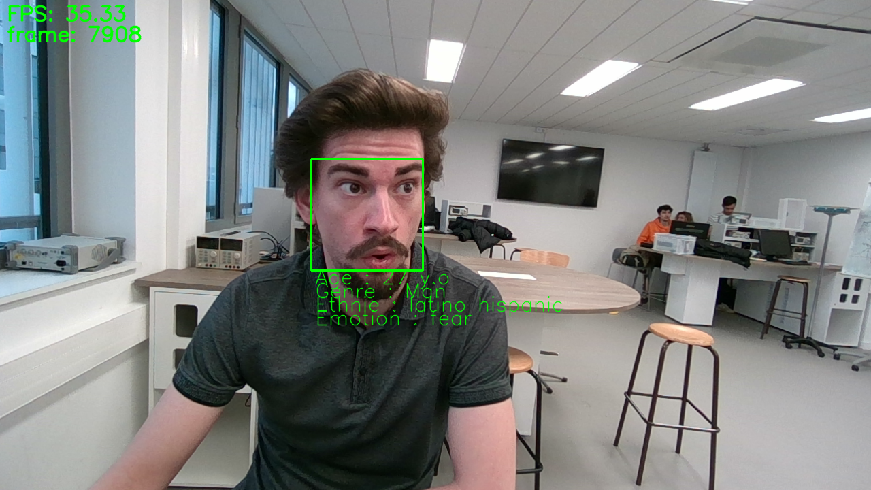
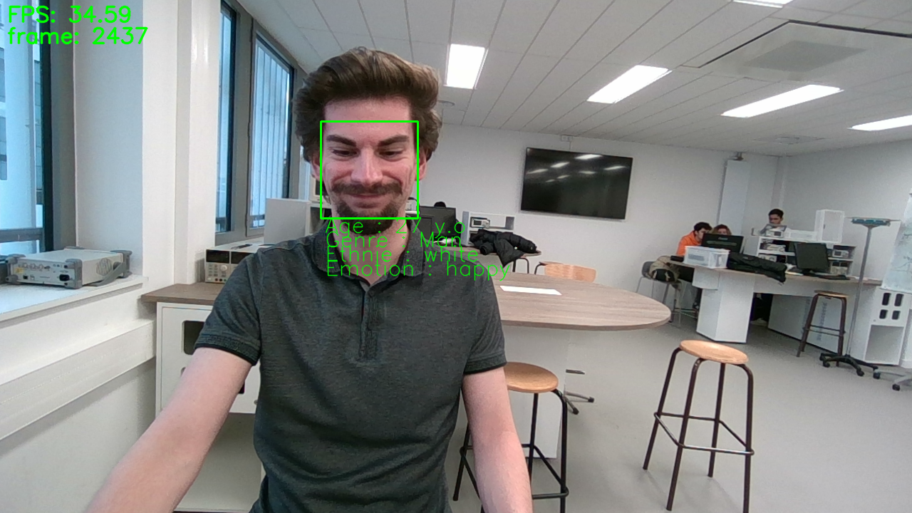
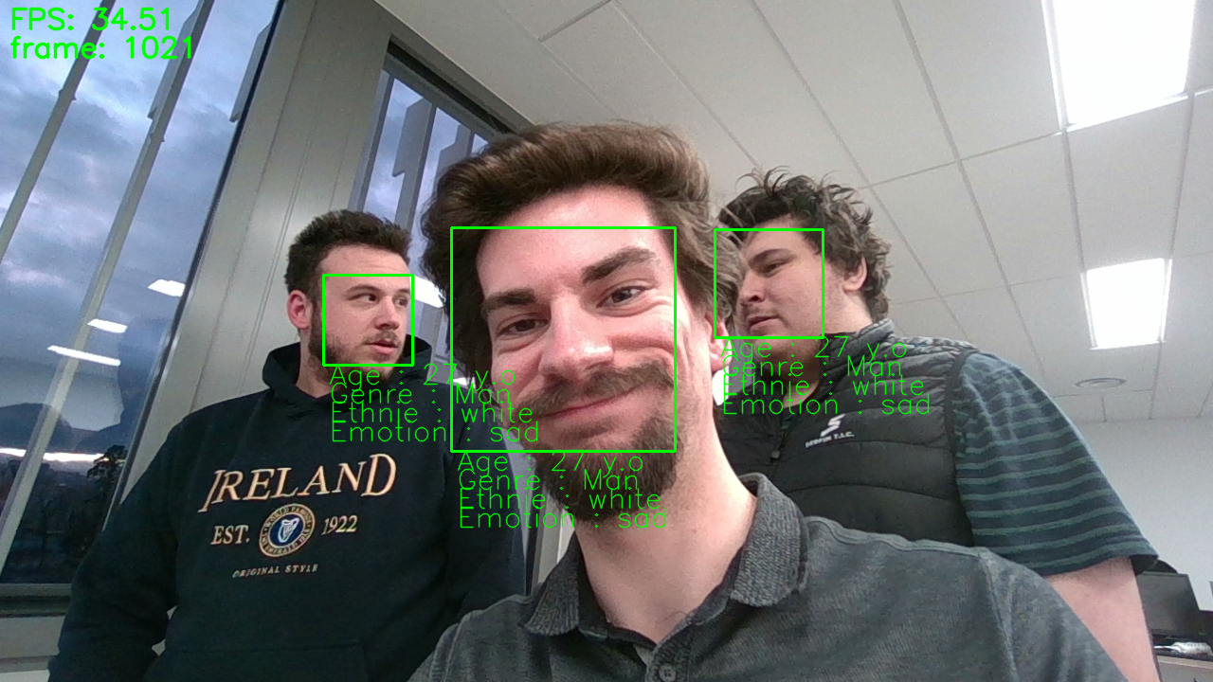
3) Fonctionnalités
FROUIN Tanguy 5IRC

Slide 12
3) Fonctionnalités
Reste à faire:
Fonctionnement sur plusieurs caméras 3D
Taxonomie
Optimisation
FROUIN Tanguy 5IRC

Slide 13
4
Difficultés
FROUIN Tanguy 5IRC

Slide 14
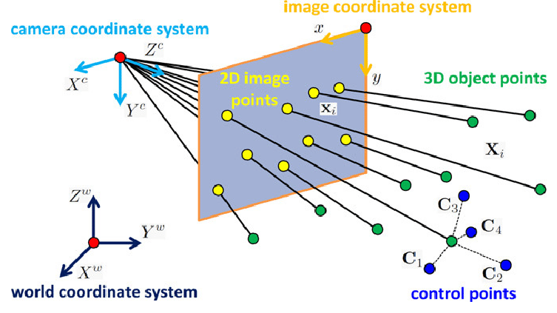
4) Difficultés
Source: researchgate
FROUIN Tanguy 5IRC

Slide 15
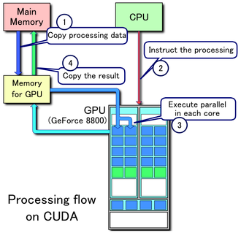
4) Difficultés
Source: wikipédia (CUDA)
FROUIN Tanguy 5IRC

Slide 16
5
Bilan personnel
FROUIN Tanguy 5IRC

Slide 17

5) Bilan personnel
Source: Adobe stock
FROUIN Tanguy 5IRC

Slide 18
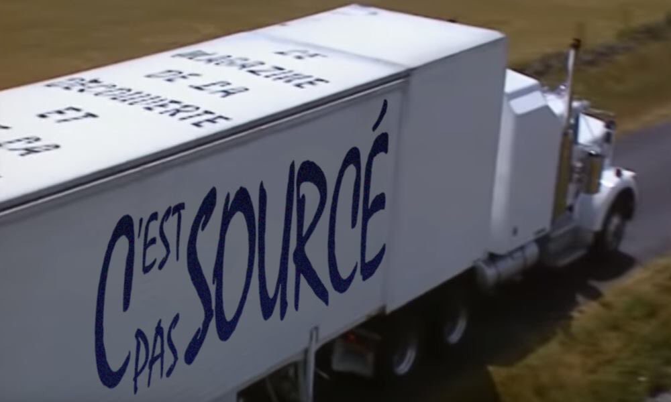
6) Sources
Awesome Lists - Articles de Recherche
https://github.com/Yochengliu/awesome-point-cloud-analysis
https://github.com/codingonion/awesome-yolo-object-detection
https://github.com/TianhaoFu/Awesome-3D-Object-Detection
Point Clouds
https://developer.nvidia.com/blog/detecting-objects-in-point-clouds-using-ros-2-and-tao-pointpillars/
https://www.stereolabs.com/docs/ros2/depth-sensing/
https://github.com/IntelRealSense/librealsense/tree/development/wrappers/python/examples
https://github.com/jamohile/stereoscopic-point-clouds
https://github.com/heremaps/pptk
https://github.com/strawlab/python-pcl
https://github.com/ros-perception/perception_pcl
https://index.ros.org/p/pcl_ros/#humble
https://academy.visualcomponents.com/lessons/import-point-cloud-with-python-api/
https://www.youtube.com/watch?v=HIRj5pH2t-Y
https://jeffzzq.medium.com/ros2-image-pipeline-tutorial-3b18903e7329
https://medium.com/@regis.loeb/playing-with-point-clouds-for-3d-object-detection-eff1d98e526a
https://medium.com/yodayoda/from-depth-map-to-point-cloud-7473721d3f
http://www.diva-portal.org/smash/get/diva2:1245296/FULLTEXT01.pdf
http://www.open3d.org/docs/release/tutorial/geometry/rgbd_image.html
http://www.open3d.org/docs/release/tutorial/geometry/pointcloud.html
https://towardsdatascience.com/how-to-use-pointnet-for-3d-computer-vision-in-an-industrial-context-3568ba37327e
Segmentation
https://docs.opencv.org/4.8.0/d1/d5c/tutorial_py_kmeans_opencv.html
https://thepythoncode.com/article/kmeans-for-image-segmentation-opencv-python
https://sites.google.com/view/aide-python/applications/traitements-et-analyses-dimages/k-means-sur-image-avec-opencv-pour-segmenter
https://www.kdnuggets.com/2019/08/introduction-image-segmentation-k-means-clustering.html
https://dev.to/andreygermanov/how-to-implement-instance-segmentation-using-yolov8-neural-network-3if9
FROUIN Tanguy 5IRC

Slide 19
6) Sources
Détection de Visages et Attributs
https://github.com/ageitgey/face_recognition
https://github.com/serengil/deepface
https://github.com/davisking/dlib
https://github.com/deepinsight/insightface
Mediapipe
https://github.com/google/mediapipe/blob/master/docs/solutions/
https://github.com/googlesamples/mediapipe/tree/main/examples
https://developers.google.com/mediapipe/solutions/guide
OpenPose
https://github.com/CMU-Perceptual-Computing-Lab/openpose
https://cmu-perceptual-computing-lab.github.io/openpose/web/html/doc/md_doc_00_index.html
https://github.com/ZheC/tf-pose-estimation
https://github.com/Daniil-Osokin/lightweight-human-pose-estimation.pytorch
https://github.com/firephinx/openpose_ros
https://github.com/ravijo/ros_openpose
Ultralytics
https://github.com/ultralytics/ultralytics/issues/2028
https://docs.ultralytics.com/
Intel RealSense
https://github.com/IntelRealSense/librealsense
https://github.com/IntelRealSense/realsense-ros
https://dev.intelrealsense.com/docs/python2
https://www.intelrealsense.com/developers/
Optimisation
https://developer.nvidia.com/cuda-toolkit
https://cupy.dev/
Credits diapo: Slidesgo, Freepik, Flaticons
FROUIN Tanguy 5IRC

Slide 20
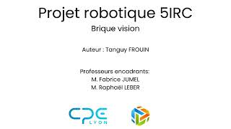
7) Démo
FROUIN Tanguy 5IRC

Slide 21
Merci d’avoir écouté
FROUIN Tanguy 5IRC

